Slide 1
Sustainable Ski Resorts
Meiringen-Hasliberg & Arosa
Daniel Leibrock, Remo Kälin and Simon Glauser for SUA01
Notes:
Daniel

Slide 2
01
02
Introduction
Data
03
03
Dashboard
Outlook
Briefing Stakeholder Analysis
Data Sources
Hypothesis
Results
Next Steps
Questions
Notes:
Daniel

Slide 3


Sustainability Project Briefing
Sustainability Project in your Ski Resorts:
How to adapt to climate change
How to become more sustainable
How to invest with long-term view
Notes:
Daniel

Slide 4
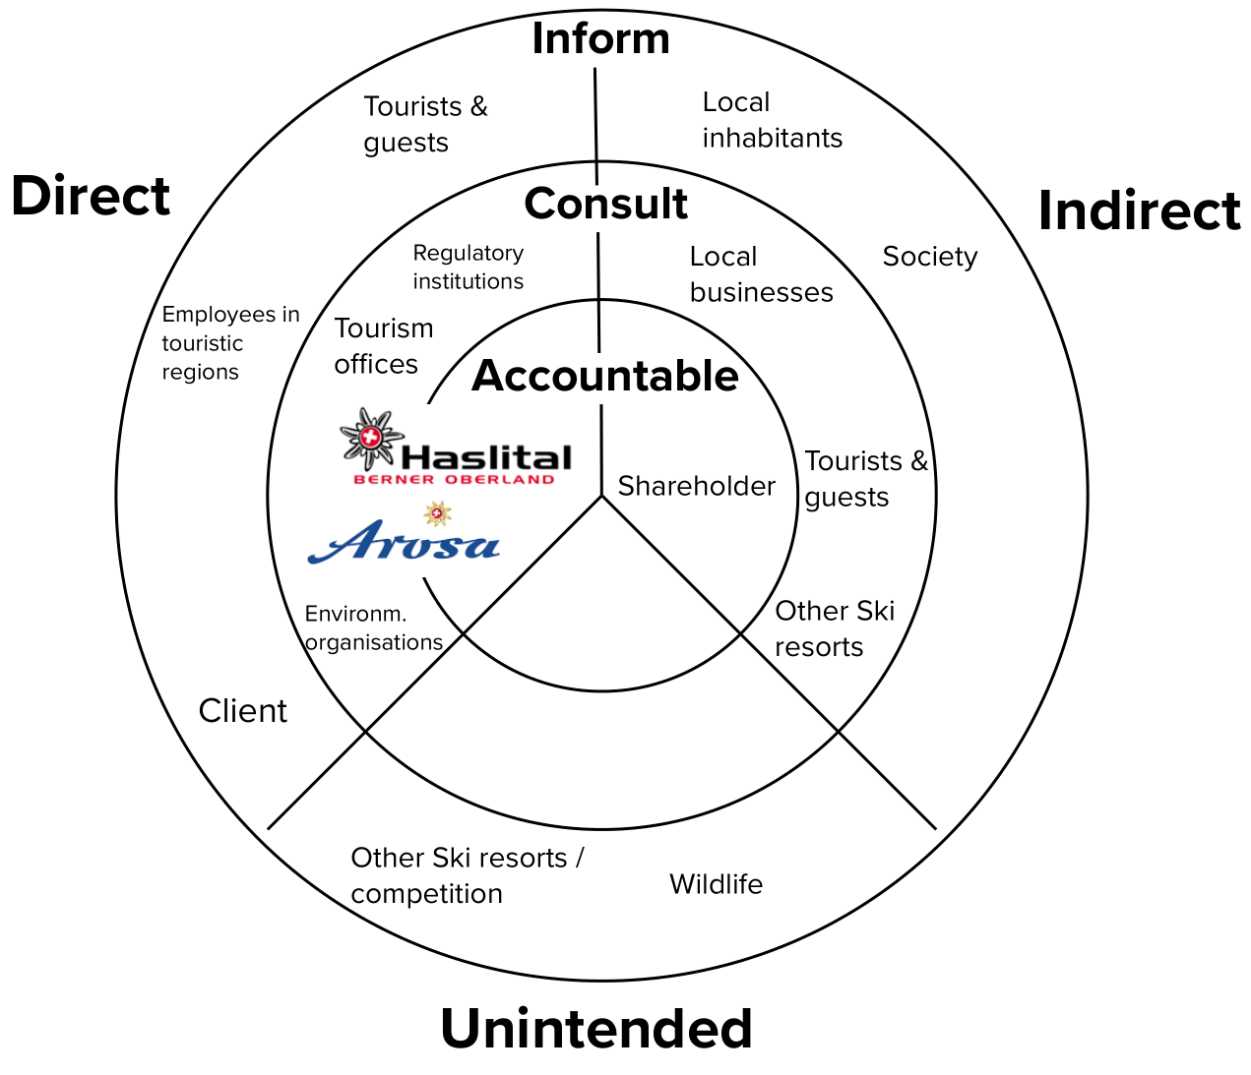

Stakeholder Analysis
Key Stakeholders
Ski Resort / Client
Local Businesses
Tourists / Guests
Notes:
Daniel

Slide 5
Hypothesis 1
Hypothesis 2
Hypothesis 3
Snow Days
Temperature
Overnight Stays
There are fewer natural-snow days now compared to the past
There is a upwards trend visible within temperature data
During winter seasons, the overnight stays are decreasing
Notes:
Daniel

Slide 6
Data Sources
Where did we get our data:
IDAWEB from BFS
Snow depth (morning measurement at 6 UTC)
Temperature (daily minimum)
STAT-TAB from BFS
Overnight Stay (monthly)
For Arosa and Meiringen/Hasliberg
Notes:
Siomon

Slide 7


Dashboard
Multi-Page Application
Built with Streamlit
Dashboard WIP
Notes:
Simon

Slide 8
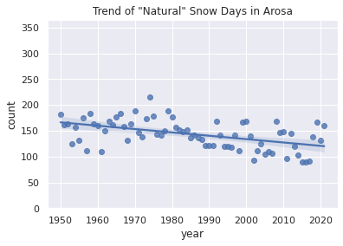
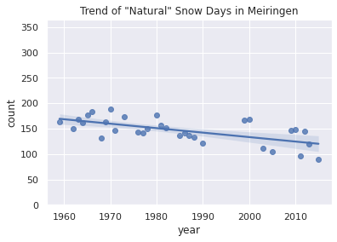
Snow Days
Natural snow height to ski: 40cm
Natural snow required for technical snow: 20cm
Clear decreasing trend observed
Notes:
Simon

Slide 9
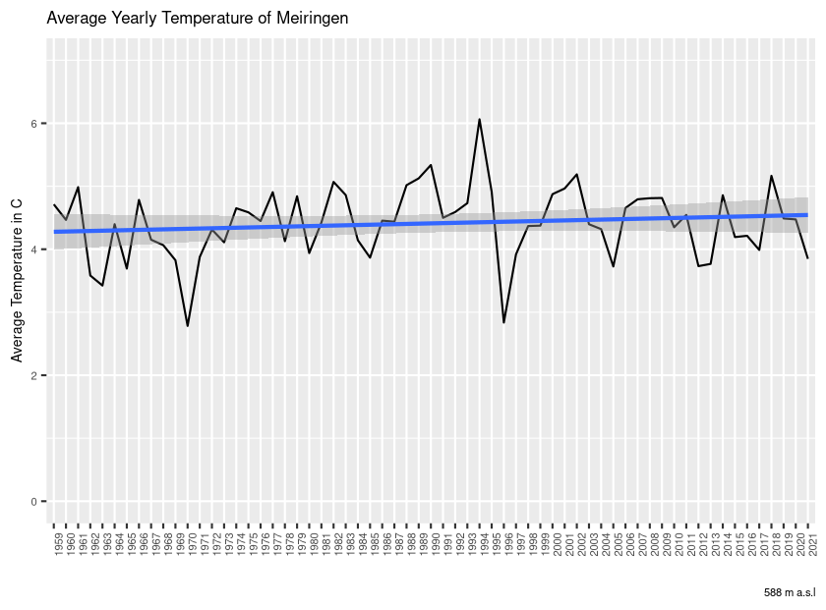
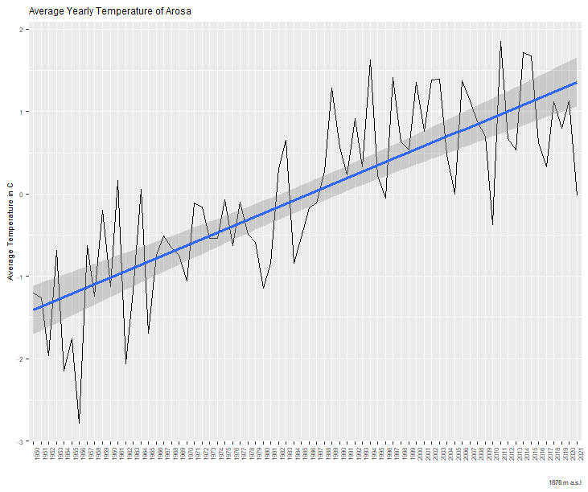
Temperature
Minimum daily average
Arosa
Meiringen
Notes:
Simon

Slide 10
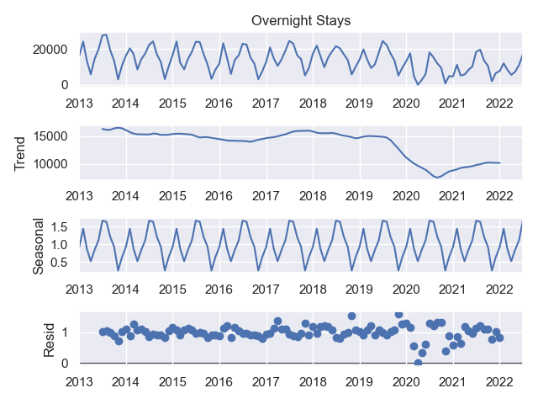
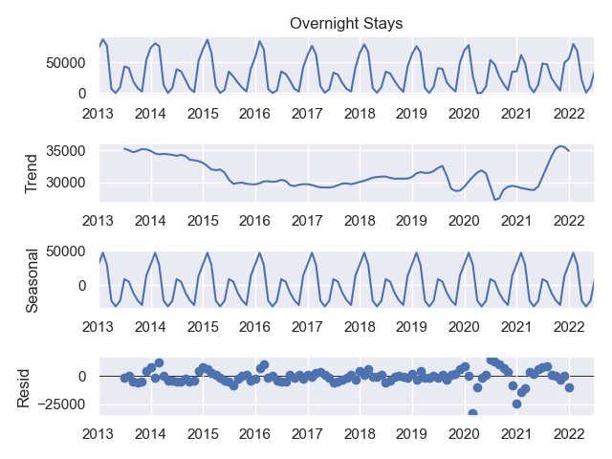
Overnight Stays
Meiringen Arosa
Notes:
Simon

Slide 11
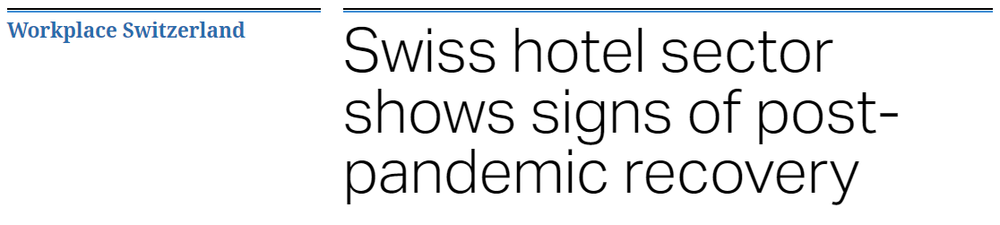
Overnight Stays
Summer: May - October / Winter: November - April
Difficult Data Analysis due to the Corona Pandemic (Black Swan Event)
The number of overnight stays between summer and winter converge in both ski resorts
Recovery in 2022 after difficult pandemic years
Notes:
Simon

Slide 12


Hypothesis 1
Hypothesis 2
Hypothesis 3
Snow Days
Temperature
Overnight Stays
There are fewer natural-snow days now compared to the past
There is a upwards trend visible within temperature data
During winter seasons, the overnight stays are decreasing

Slide 13

Next Step (Financial)
Investigate the financial and environmental impact of snow guns in Arosa and Meiringen/Hasliberg and create a long-term sustainable investment strategy.
Notes:
Remo

Slide 14
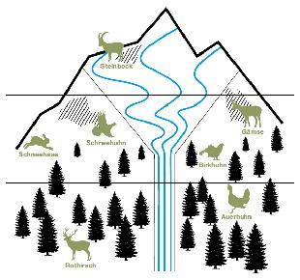
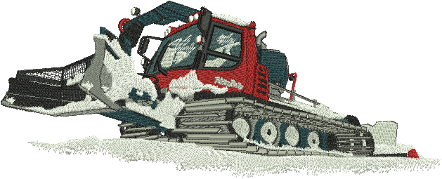
Next Steps (Environmental)
Investigate the impact of year-round alpine resort operations on wildlife with respect to:
Resting periods
Mating season
Noise Pollution
Notes:
Remo

Slide 15

Next Steps (General)
Integrate other ski resorts into the analysis to see the trends better
Do a more precise analyses and take more variables into the analysis
Further develop dashboard and make it accessible to all stakeholders
Notes:
Remo

Slide 16

THANKS!
Notes:
Remo

